Slide 1

Digital Volume Meter
Electronic Engineering Williamwood Skills Academy, 2022

Slide 2
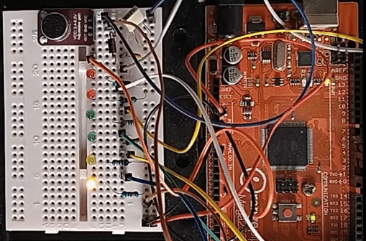
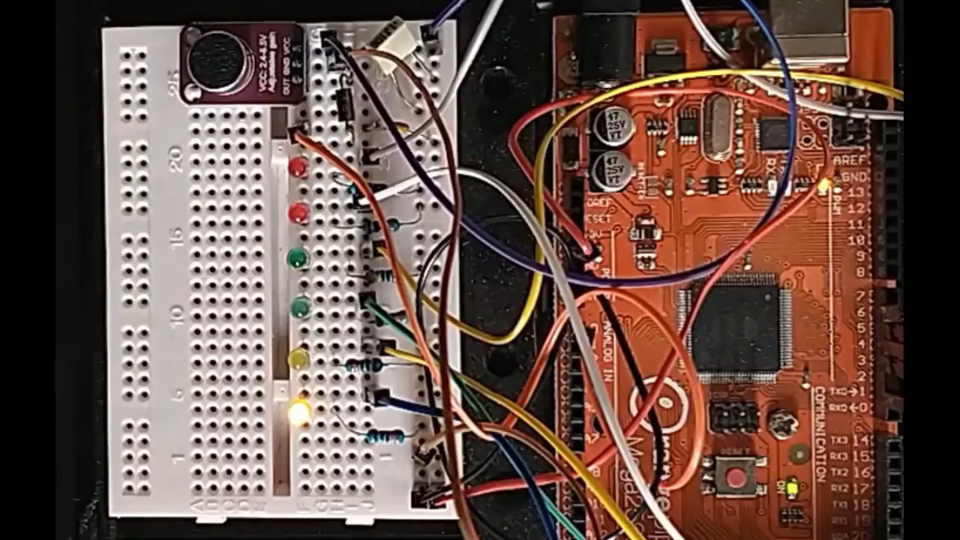
What's the Plan?
We will create a digital volume meter, where LED lights react to the volume of your voice/music
Build the electronic circuit
Program the microcontroller
Experiment!

Slide 3
Our Goals
By the end you will...
Understand the basics of electronic circuits and computer programming
Experience building practical electronic circuits using individual components
Gain an insight into how software and hardware work together in everyday electronic devices

Slide 4
Building the Circuit

Slide 5
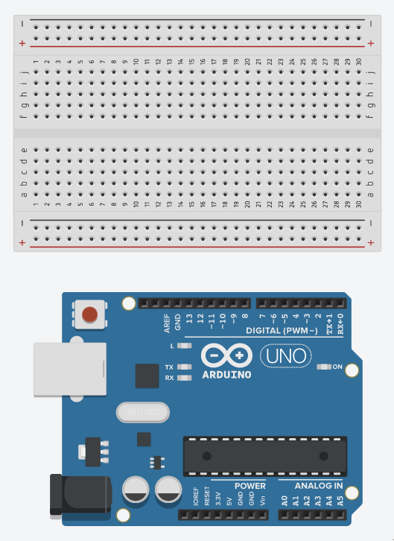
📋
Setting Up
Breadboard →
Stick the breadboard and Arduino Uno to your desk using blue tac, as shown
Connect the Arduino to the computer using the USB cable
The light labelled L should light up 💡
Arduino Uno →

Slide 6
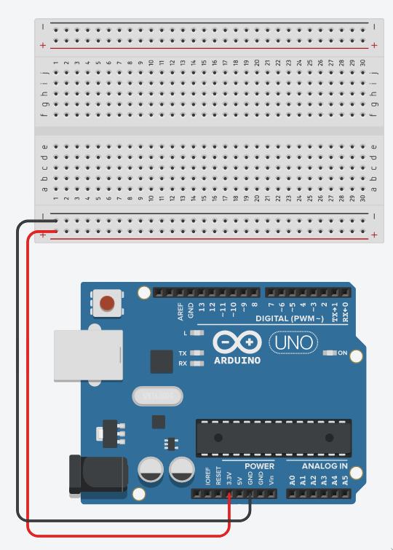
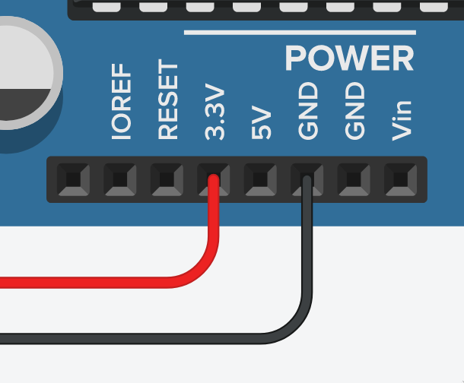
📋
Setting Up
Connect the socket labelled 3.3V to the breadboard, as shown
Connect the socket labelled GND to the breadboard, as shown

Slide 7
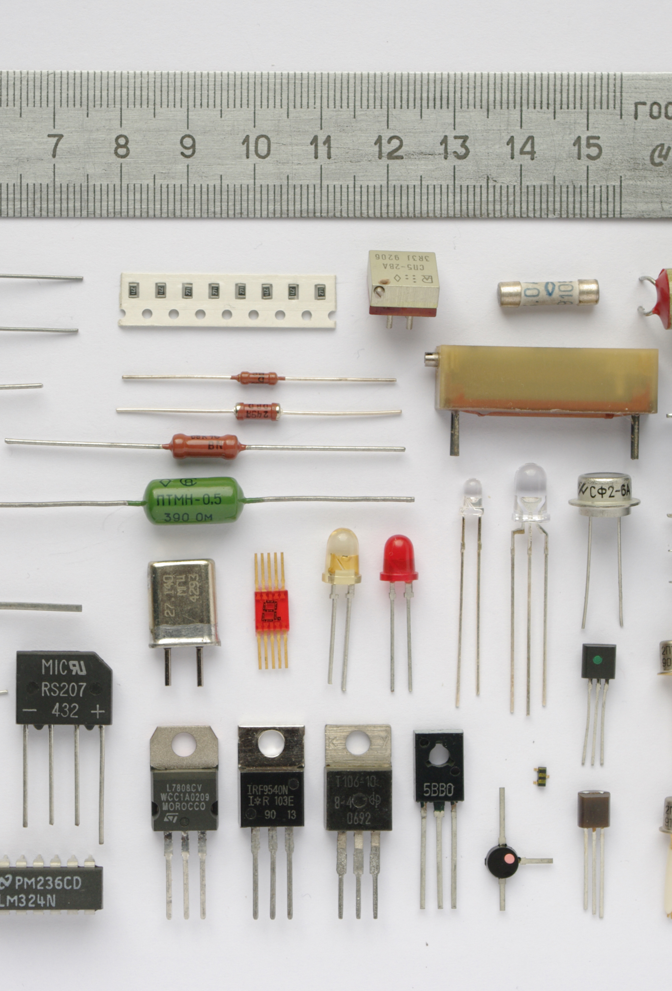
What is a Circuit?
ℹ️
A circuit is made up of small, individual devices called electronic components
Components control the flow of electricity
Can be connected together to make almost any kind of device – TVs, phones, radios, computers, washing machines...
Combination of components is called a circuit

Slide 8
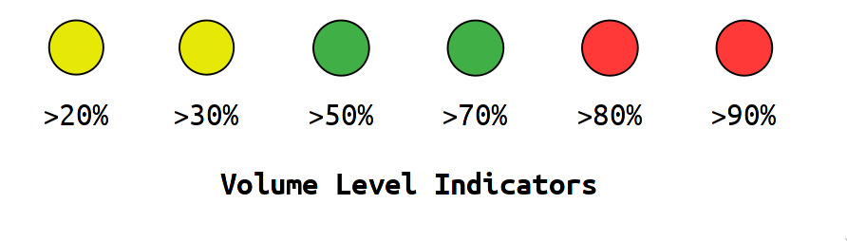
Volume Level Indicators
ℹ️
The first circuit we'll look at is the display of our volume meter
We want a row of lights which tell us how loud a sound is
It should work so that each light can be either on or off

Slide 9
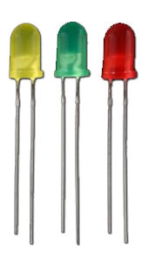
Light Emitting Diodes
ℹ️
An LED is an electronic component which creates light when electricity is pass through it
Like tiny light bulbs
Use very little electricity
We will use them to display the volume level

Slide 10
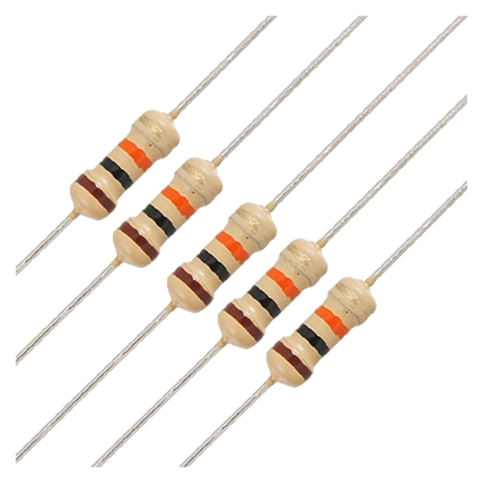
Resistors
ℹ️
Resistors control the flow of electricity in circuits
Found in almost any electronic circuit
We will use them to control the brightness of our LEDs

Slide 11
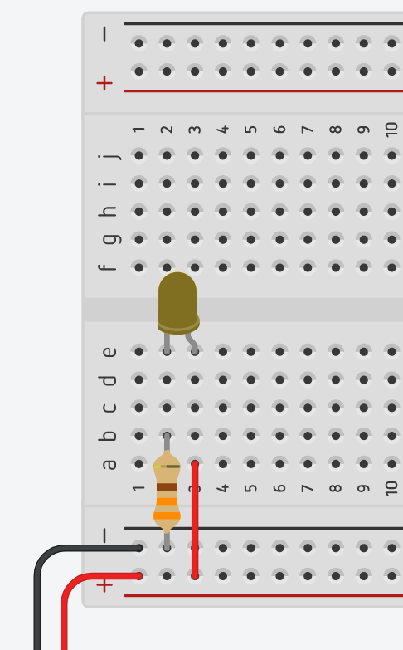
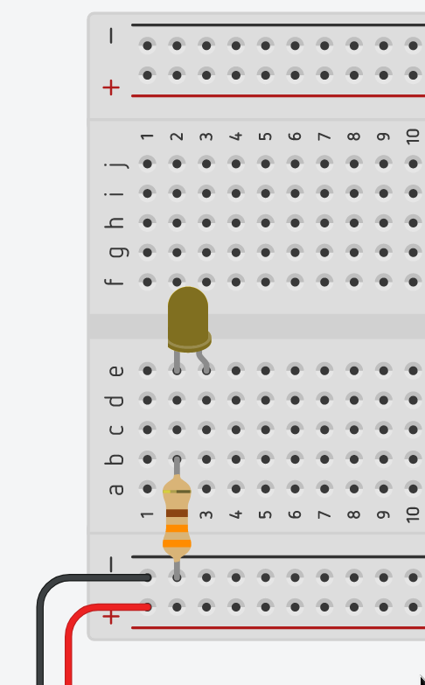
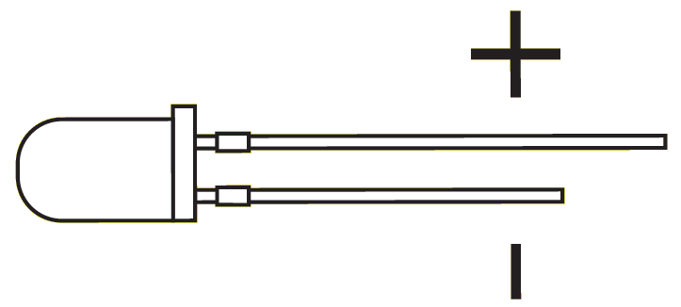
📋
Our First LED
Connect up a yellow LED and resistor, as shown
Short leg left, long leg right!
Connect the right side of the LED to the red rail, as shown
The LED should light up 💡

Slide 12
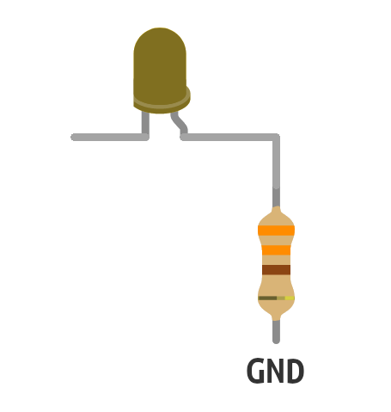
How Does the LED Turn On?
❓
The LED lights when electricity is pushed through it
Electricity is pushed around by a force called voltage
Without this pressure, electricity can't flow

Slide 13
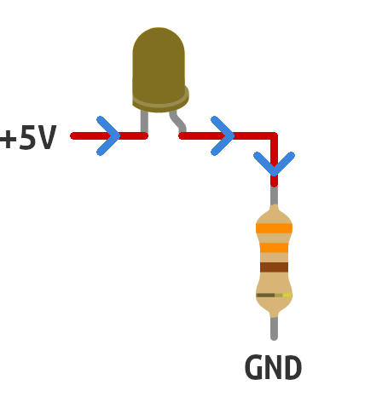
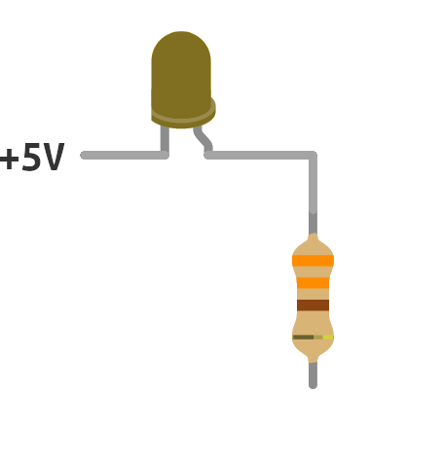
Why Does the LED Turn On?
❓
Ground is where there is no voltage (0V)
Electricity wants to return to ground – think lightning
Electricity can't flow if there is no path to ground

Slide 14
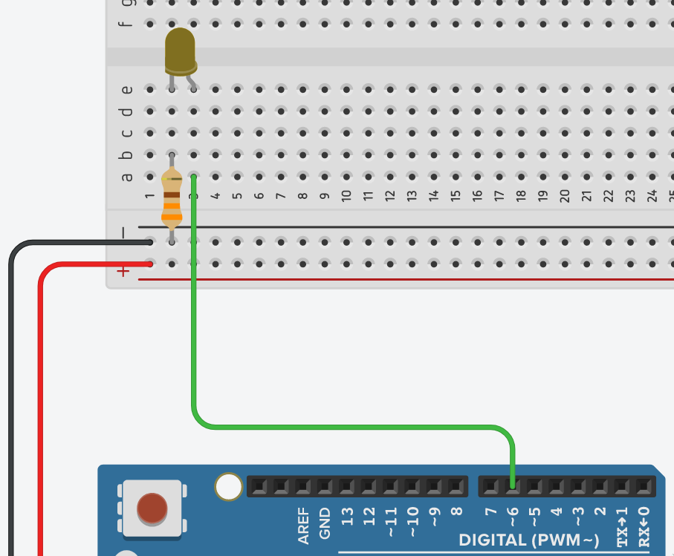
📋
Our First LED
Remove the test wire
Connect the right side of the LED to the socket labelled 6 on the Arduino, as shown
The Arduino can now control the LED...

Slide 15

Arduino Uno
ℹ️
A microcontroller board
Contains a simple computer system on a single chip
Sockets so we can easily connect to the chip
Can be programmed to do almost anything...

Slide 16
Arduino Uno
ℹ️
Output sockets can switch between 5V or 0V
Will be programmed to decide which LEDs to turn on/off

Slide 17
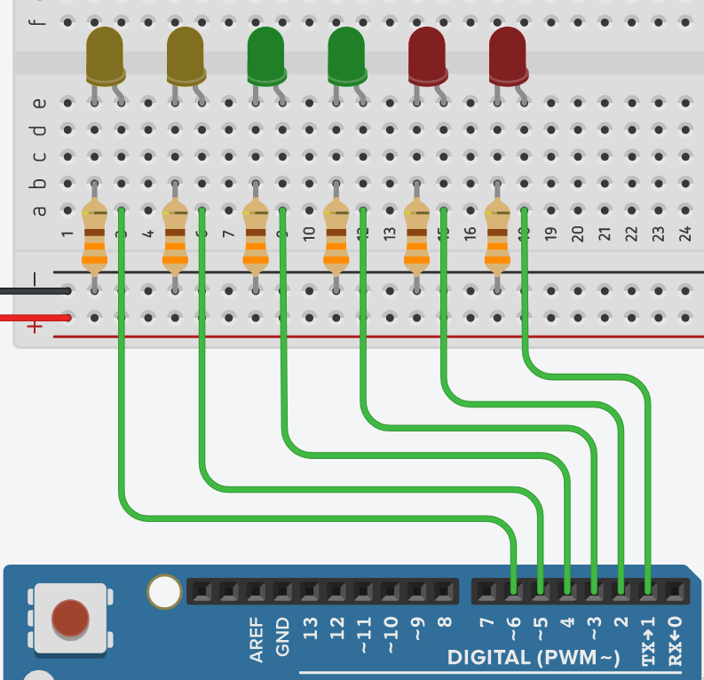
A B C D E F
📋
Wiring LEDs
Connect up all 6 LEDs, as shown
Short leg left, long leg right!
Make sure you connect each LED to the correct socket, e.g. LED A → 6, LED B → 5

Slide 18
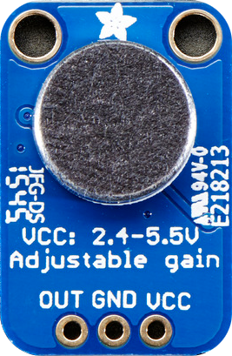
Microphone
ℹ️
Converts sound into electricity
Quiet sounds create small voltages
Loud sounds create larger voltages

Slide 19
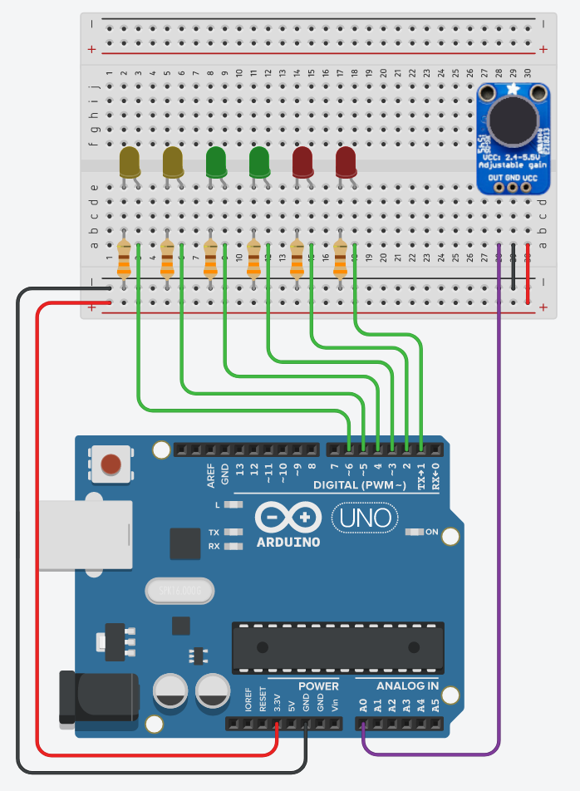
📋
Adding the Microphone
Connect up the microphone, as shown
Make sure you connect the OUT pin to the socket labelled A0 on the Arduino

Slide 20
Programming the Microcontroller

Slide 21

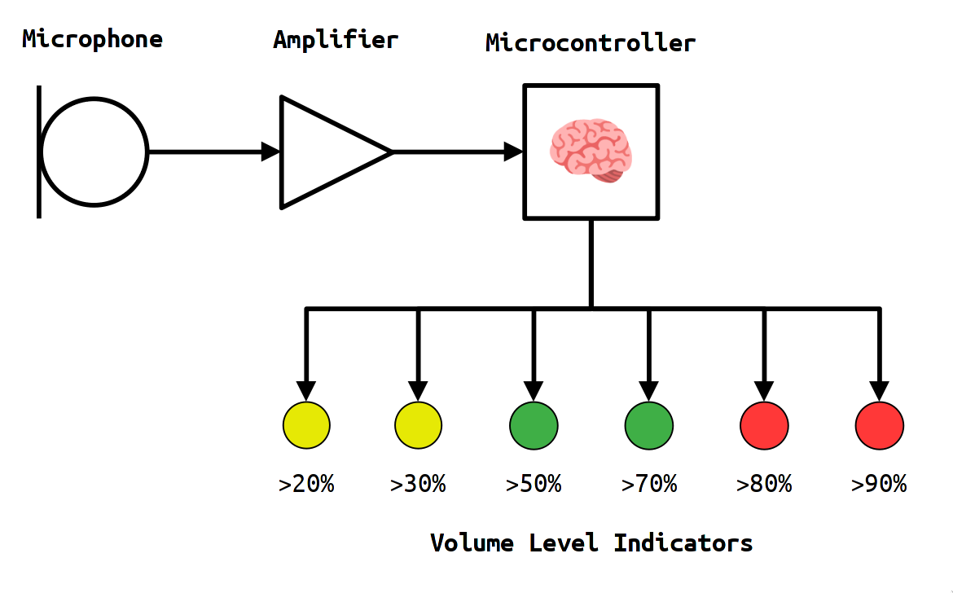



How loud is this sound?

Slide 22
What is a Program?
ℹ️
A program is a set of instructions that a computer follows to achieve a task
Creating a program has two steps:
Deciding what the set of instructions should be
Giving the computer the instructions in a way that it can understand

Slide 23

Computers Are Dumb
ℹ️
Computers take things literally
They need precise list of instructions to follow - they will only do exactly what you tell it to

Slide 24


📋
Tea Making Robot
Your task is to create an set of instructions for a tea making robot
What steps would the robot need to do to make a cup of tea?
What information would it need to ask the user?

Slide 25
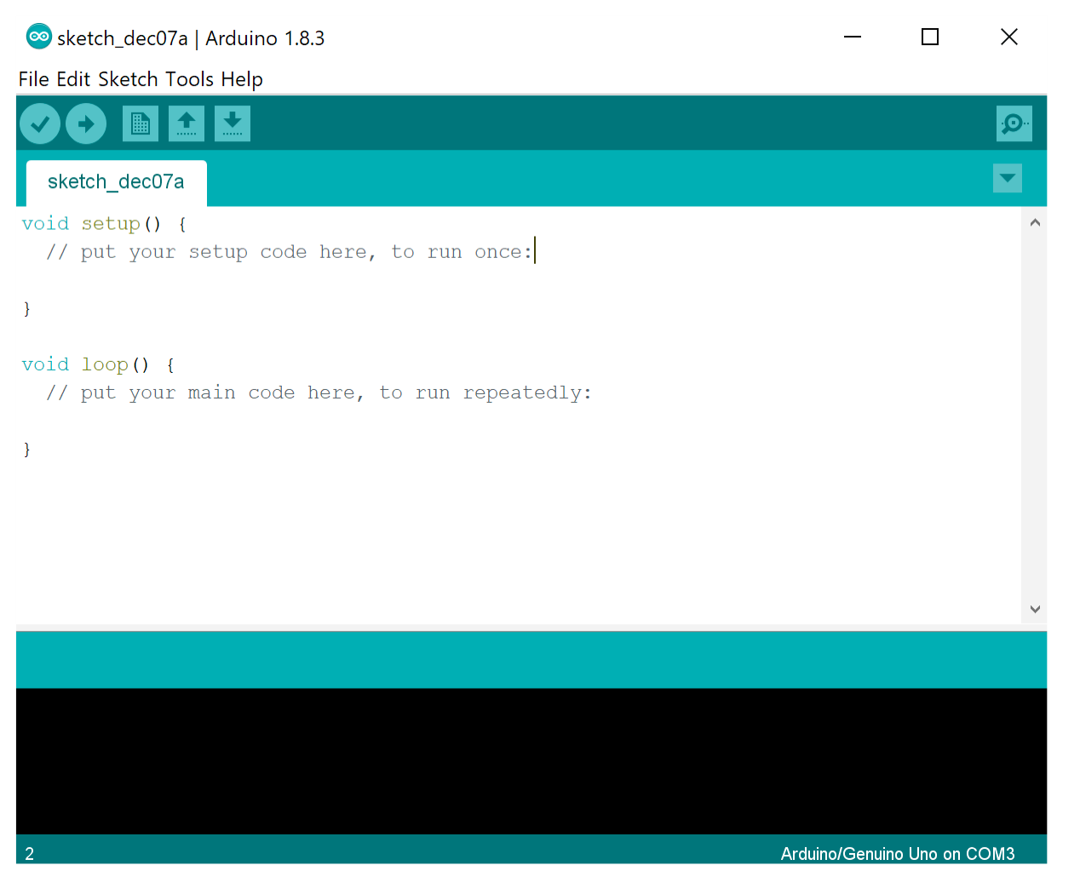

Arduino IDE
Used to type up our programs
Upload our programs to the microcontroller
To open it on your computer:
Go to the Windows start menu in the bottom left of the screen
Type in “Arduino”

Slide 26
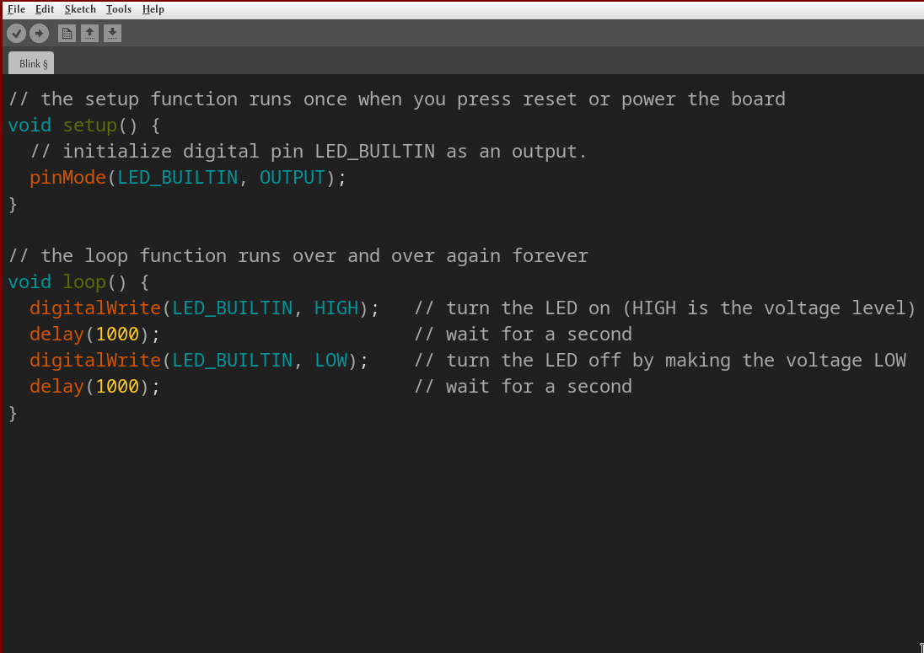
📋
Test Program
Let’s test if the Arduino IDE can talk to our microcontrollers
Open the test program by going to File > Examples > 01.Basics > Blink

Slide 27
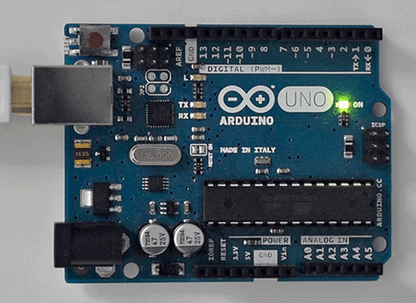
📋
Test Program
Select the correct microcontroller: Tools > Board > Arduino AVR Boards > Arduino Uno
Select the port: Tools > Port > COMx (Arduino Uno)
Upload the program: Sketch > Upload

Slide 28
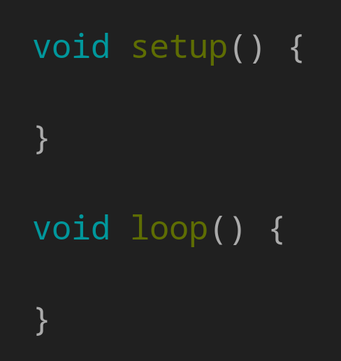
Structure of a Program
ℹ️
All microcontroller programs have two main sections
setup runs its instructions once at the beginning
loop repeats its instructions over and over again forever

Slide 29
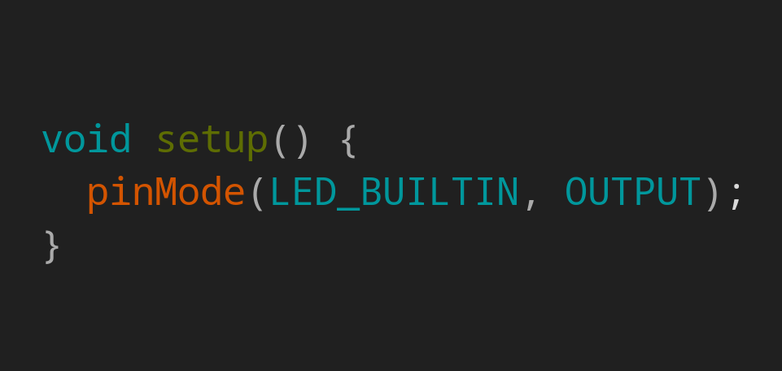
Inputs and Outputs
ℹ️
pinMode tells the microcontroller if a pin is an input or an output
An OUTPUT delivers electricity a device, e.g. LED
An INPUT receives electricity from a device, e.g. microphone

Slide 30
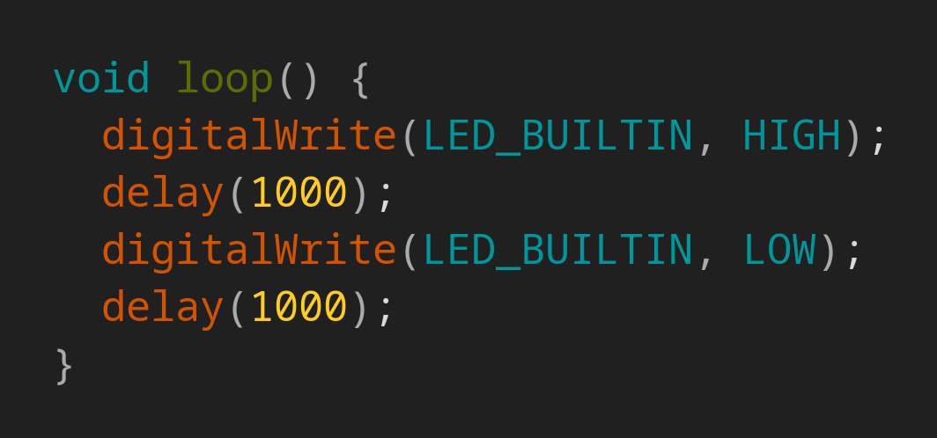
Blinking
ℹ️
digitalWrite tells a pin what it should output
HIGH makes the output 5V
LOW makes the output 0V
delay stops the program, in milliseconds (1000ms = 1s)

Slide 31
Blinking
ℹ️
Turn LED on
Wait 1 second
Turn LED off
Wait 1 second

Slide 32
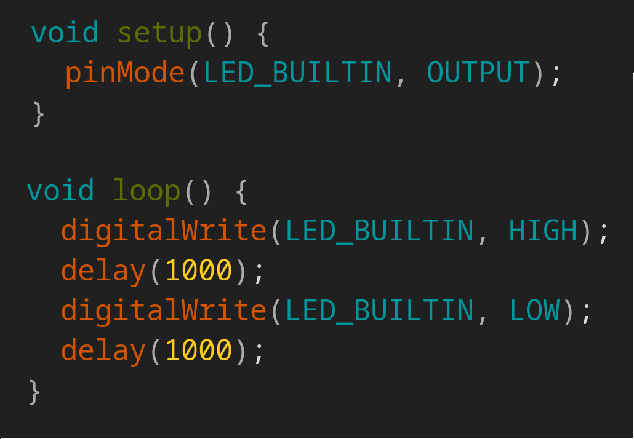
📋
Blinking Your LED
Try changing the test program so that it blinks the LED connected to pin 6
Try changing the test program so that it blinks every half second (500ms)

Slide 33

📋
Starting the Volume Meter Program
Create a new program by going to File > New in the Arduino IDE
We’ll go through an incomplete version of the program I have written, section by section
I’ll explain what the program is doing
Your job is to complete the program

Slide 34
Programming Advice
ℹ️
Do your best to copy the program exactly
Keep in mind that it is case sensitive
Be sure to share the typing responsibility with your partner
While one types, the other watches for mistakes

Slide 35
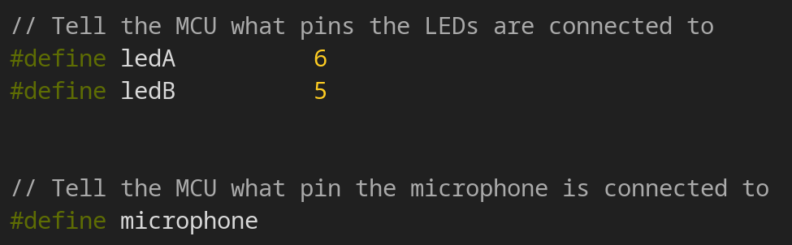
📋
Setting Up Our Pins
Complete for all LEDs
What pin is the microphone connected to?

Slide 36
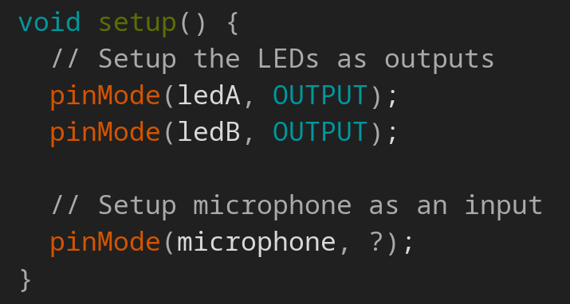
📋
Setting Inputs and Outputs
Complete for all LEDs
Is the microphone an input or an output?

Slide 37
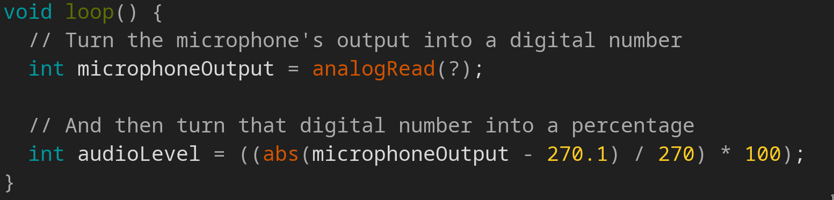
📋
Getting the Volume from the Microphone
What would we type here to read from the microphone pin?

Slide 38

📋
Turning on the LEDs
The program now knows how loud the audio is
So we can program the microcontroller to decide what LEDs to turn on
We will do this by using if/else statements
The following code should go inside the loop

Slide 39
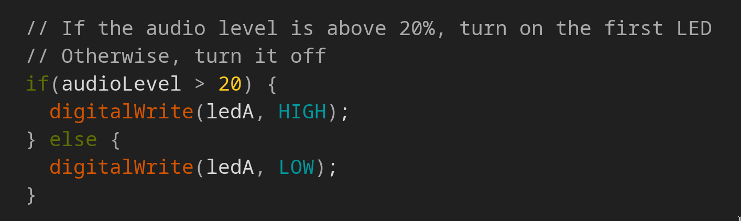
📋
Turning on the LEDs
Complete for all LEDs

Slide 40
📋
Uploading Our Program
We have now completed the first version of our program!
To test it, upload your program by going to Sketch > Upload
Try speaking/playing music into it
Think if there is anything you’d like to change about it. Is it too flickery? Too sensitive/not sensitive enough?

Slide 41
Experiment!

Slide 42

📋
Can We Change the Sensitivity?
All of the microphones are slightly different
Levels of sensitivity might be different across the class
Let’s try and change our program so we can easily set how sensitive the volume meter is

Slide 43
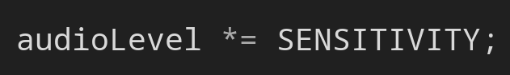
📋
Adding a Sensitivity Control
At the very top of the program add this line:
Then underneath int audioLevel = … add this line:

Slide 44
📋
Testing the Sensitivity Control
Try changing the value of our new sensitivity control
What happens when you make the number smaller?
What happens when you make the number bigger?
Remember to upload your program!

Slide 45
📋
Smoothing Out the Flicker
You might notice that your volume meter flickers
Let’s try and make the LED's response smoother (less flickery)
We can do this by adding an envelope detector circuit

Slide 46
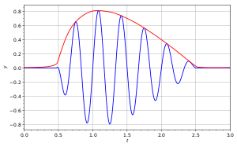
Envelope Detector
ℹ️
Microphone output is a constantly changing electrical signal (blue)
An envelope detector smooths out this type of signal (red)

Slide 47
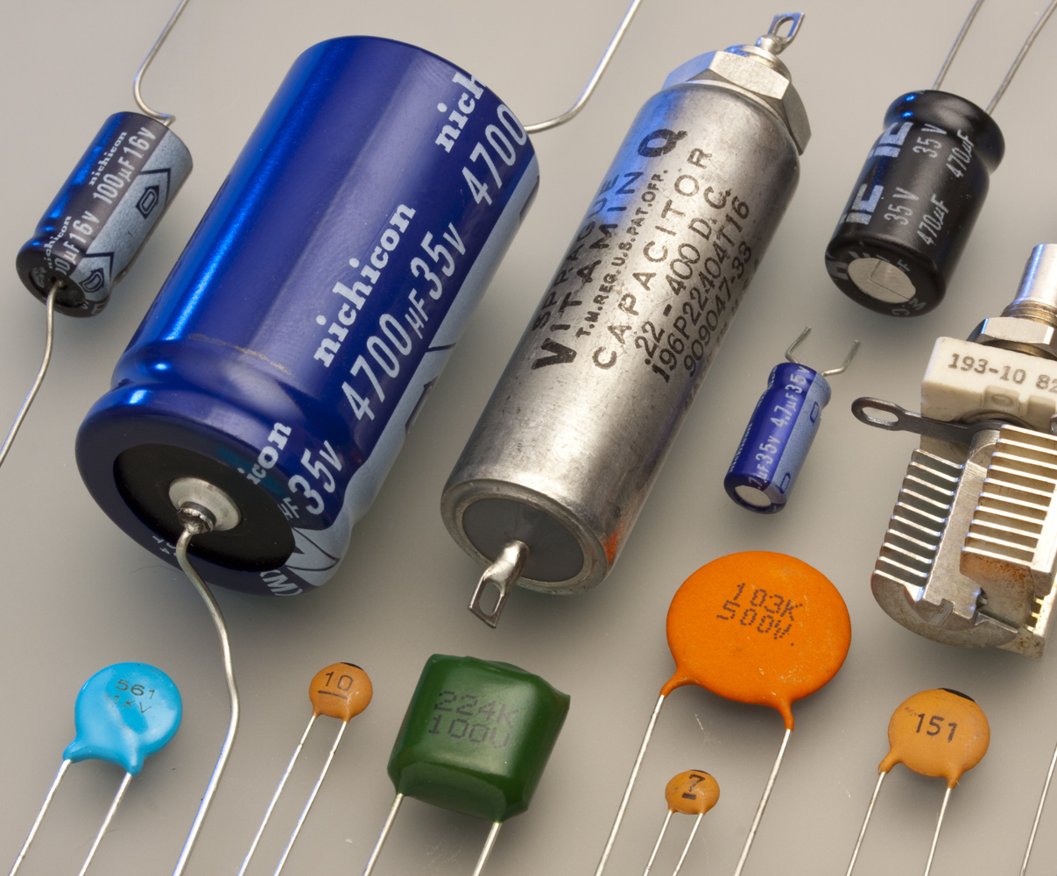
Capacitors
ℹ️
Store electricity – think batteries
Charge and discharge slowly
Capacitance is a measure of how much electricity it can store
Bigger capacitance = more time to charge/discharge

Slide 48
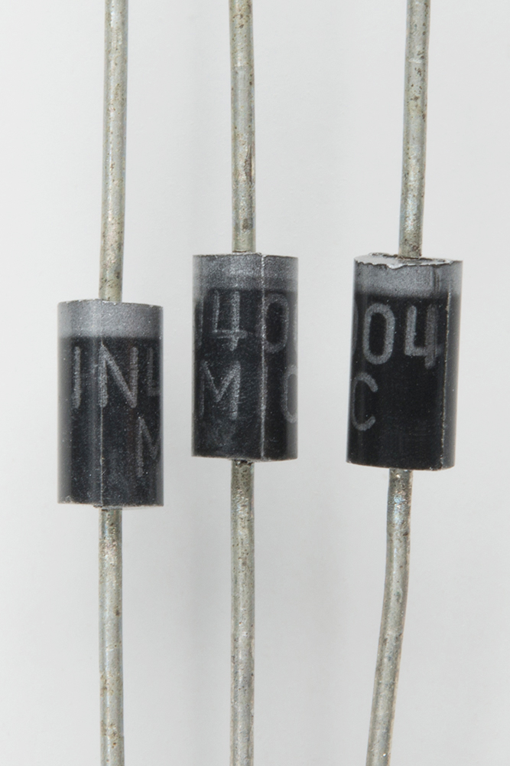
Diodes
ℹ️
Allow positive voltages to flow through them
Block negative voltages from flowing through them

Slide 49
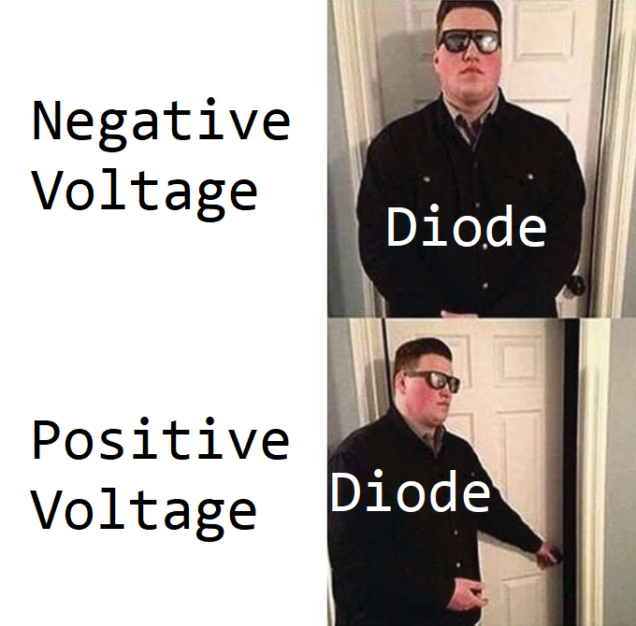
Diodes
ℹ️

Slide 50
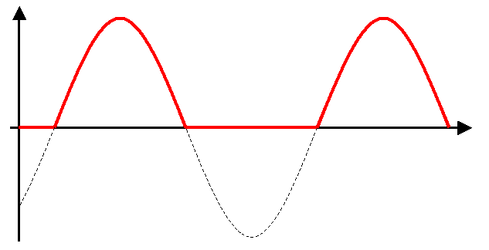
Diodes
ℹ️
Constantly changing electrical signals constantly change between positive to negative voltages
If passed through a diode, the negative half is blocked

Slide 51
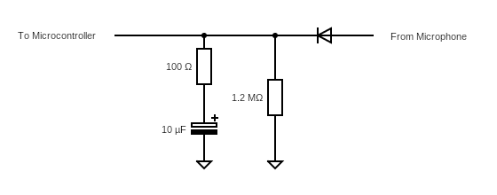
Circuit Diagram
ℹ️

Slide 52
📋
Building the Envelope Detector Circuit
Create the envelope detector circuit, as shown
Make sure the white bands on the diode and capacitor are pointing away from the microphone!
100Ω
10uF
1.2MΩ

Slide 53
📋
Experimenting with the Envelope Detector Circuit
What happens if you use a larger capacitor value?
What is you use a smaller capacitor value?
What happens if you remove the 1.2MΩ resistor?
100Ω
10uF
1.2MΩ

Slide 54
📋
Flipping the LEDs
Let’s try changing the program so that the LED’s behavior flips, i.e.
When there is no sound all LEDs are on
When the sound is >20% turn off LED A etc.
Hint: you want to look at your if/else statements

Slide 55
Wrapping Up

Slide 56
What Have We Achieved?
We have created a digital volume meter from scratch!
Learned how to build practical electronic circuits
Learned how simple electronic circuits work
Learned the basics of computer programming

Slide 57
Feedback
Anything else you’d want to improve about your volume meter?
Is this class what you expected? Is there anything you would change about the class?

Slide 58

📋
Clearing Up
Put away all of your components
Reset your microcontrollers using the Arduino IDE:
Go to File > New
Then Sketch > Upload

